Slide 1
Chapter 3 Objectives
The CCNA Topics Covered in this chapter include:
  Why we need DHCP
  DHCP Messages
  Relay Agent

Slide 2
DHCP Basics

Slide 3
What is DHCP
“Dynamic Host Configuration Protocol” (RFC 2131)
Automatically assigns IP addresses to devices (I.e. hosts) on your network
  Protocol for providing configuration parameters to hosts over network
  Dynamic allocation of IP addresses
  Prevents having to manually enter data
  Prevents typos that can cause connectivity problems or disrupt the network (e.g., exchanging IP address and gateway address)

Slide 4




Sample Network
DHCP Clients
DHCP Server
UDP Port 68
UDP Port 68
UDP Port 68
UDP Port 67
Router
Internet

Slide 5
DHCP Conversation
Four step process between client (UDP port 68) and servers (UDP port 67)
  Client sends Discover “Someone send me an address”. This is a broadcast.
  Servers Offer “Use this address”.
  Client Requests “I’ll use this one”. (broadcast)
  Servers Acknowledge “OK or No Way!” (ACK/NAK)

Slide 6
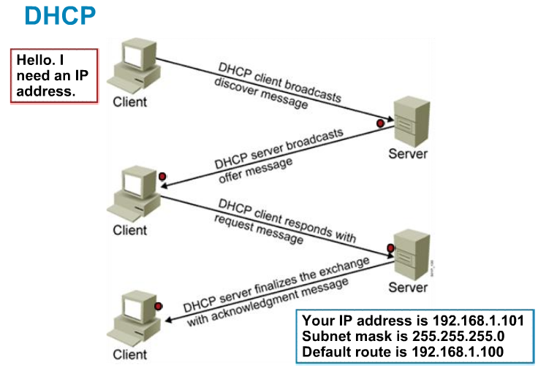
Dynamic Host Configuration Protocol
Dynamic Host Configuration Protocol (DHCP) is used to provide IP information to hosts on your network. DHCP can provide a lot of information, but the most common is IP address, subnet mask, default gateway, and DNS information.

Slide 7
DHCP Message Types
DHCP Message | Use
DHCPDISCOVER | Client broadcast to locate available servers
DHCPOFFER | Server to client response offering configuration parameters
DHCPREQUEST | Client broadcast requesting offered parameters
DHCPDECLINE | Client to server notification that IP address is in use
DHCPACK | Server to client response confirming a request
DHCPNAK | Server to client response denying a request
DHCPRELEASE | Client to server request to relinquish IP address
DHCPINFORM | Client to server request for configuration parameters

Slide 8
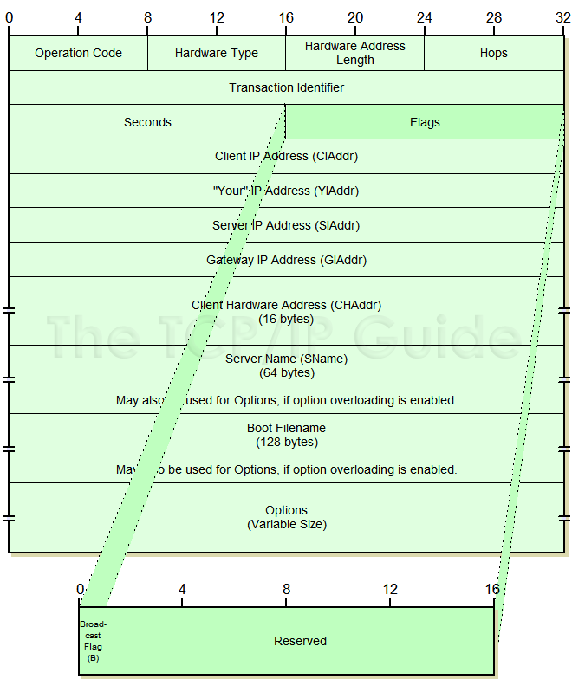
DHCP Message Format

Slide 9
DHCP Message Fields
code: Indicates a request or a reply
  1 Request
  2 Reply
HWtype: The type of hardware, for example:
  1 Ethernet
  6 IEEE 802 networks
length: Hardware address length in bytes. E.g., Ethernet and token-ring both use 6 bytes.
hops: The client sets this to 0. It is incremented by a router that relays the request to another server and is used to identify loops. RFC 951 suggests that a value of 3 indicates a loop.

Slide 10
DHCP Message Fields
Transaction ID: A random number used to match this boot request with the response it generates.
Seconds: Set by the client. It is the elapsed time in seconds since the client started its boot process.
Flags field: The most significant bit of the flags field is used as a broadcast flag. All other bits must be set to zero, and are reserved for future use. Normally, DHCP servers attempt to deliver DHCP messages directly to a client using unicast delivery. The destination address in the IP header is set to the DHCP your IP address and the MAC address is set to the DHCP client hardware address. If a host is unable (not capable – older PCs) to receive a unicast IP datagram until it knows its IP address, then this broadcast bit must be set (=1) to indicate to the server that the DHCP reply must be sent as an IP and MAC broadcast. Otherwise this bit must be set to zero.

Slide 11
DHCP Message Fields
Client IP address: Set by the client. Either its known IP address, or 0.0.0.0.
Your IP address: Set by the server if the client IP address field was0.0.0.0.
Server IP address: Set by the server.
Router IP address: This is the address of a BOOTP relay agent, not a general IP router to be used by the client. It is set by the forwarding agent when BOOTP forwarding is being used
Client hardware address: Set by the client. DHCP defines a client identifier option that is used for client identification. If this option is not used the client is identified by its MAC address.

Slide 12
DHCP Message Fields
Server host name: Optional server host name terminated by X'00'.
Boot file name: The client either leaves this null or specifies a generic name, such as router, indicating the type of boot file to be used. In a DHCPDISCOVER request this is set to null. The server returns a fully qualified directory path name in a DHCPOFFER request. The value is terminated by X'00'.
Options: Subnet Mask, Name Server, Hostname, Domain Name, Forward On/Off, Default IP TTL, Broadcast Address, Static Route, Ethernet Encapsulation, X Window Manager, X Window Font, DHCP Msg Type, DHCP Renewal Time, DHCP Rebinding, Time SMTP-Server, SMTP-Server, Client FQDN, Printer Name, …

Slide 13
DHCP Message Type
Message type is sent as an option.
Value | Message Type
1 | DHCPDISCOVER
2 | DHCPOFFER
3 | DHCPREQUEST
4 | DHCPDECLINE
5 | DHCPACK
6 | DHCPNAK
7 | DHCPRELEASE
8 | DHCPINFORM

Slide 14
Initial Message Flow
Server A
Client
Server B
Client attempts to discover available DHCP servers
DHCPDISCOVER
DHCPDISCOVER
Servers reply with offers
DHCPOFFER
DHCPOFFER
Client collects offers and decides which offer to accept
Client broadcasts request for one of the received offers
DHCPREQUEST
DHCPREQUEST
Server acknowledges client’s use of IP address
Configuration complete
DHCPACK
Graceful shutdown
Client explicitly releases use of IP address
DHCPRELEASE

Slide 15
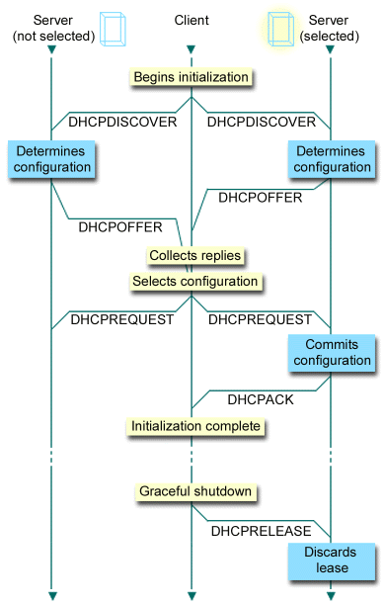
Initial Message Flow

Slide 16
DHCP Message Type
DHCPDISCOVER: Broadcast by a client to find available DHCP servers.
DHCPOFFER: Response from a server to a DHCPDISCOVER and offering IP address and other parameters.
DHCPREQUEST: Message from a client to servers that does one of the following:
  Requests the parameters offered by one of the servers and declines all other offers.
  Verifies a previously allocated address after a system or network change (a reboot for example).
  Requests the extension of a lease on a particular address.

Slide 17
DHCP Message Type
DHCPACK: Acknowledgement from server to client with parameters,
including IP address.
DHCPNACK: Negative acknowledgement from server to client, indicating that the client's lease has expired or that a requested IP address is incorrect.
DHCPDECLINE: Message from client to server indicating that the offered address is already in use.
DHCPRELEASE: Message from client to server canceling remainder of a lease and relinquishing network address.
DHCPINFORM: Message from a client that already has an IP address (manually configured for example), requesting further configuration parameters from the DHCP server.

Slide 18
Client Server Interactions
The client broadcasts a DHCPDISCOVER message on its local physical subnet.
  The DHCPDISCOVER message may include some options such as network address suggestion or lease duration.
Each server may respond with a DHCPOFFER message that includes an available network address (your IP address) and other configuration options.
  The servers record the address as offered to the client to prevent the same address being offered to other clients in the event of further DHCPDISCOVER messages being received before the first client has completed its configuration.

Slide 19
Contd.
The client receives one or more DHCPOFFER messages from one or more servers.
  The client chooses one based on the configuration parameters offered and broadcasts a DHCPREQUEST message that includes the server identifier option to indicate which message it has selected and the requested IP address option, taken from your IP address in the selected offer.
  In the event that no offers are received, if the client has knowledge of a previous network address, the client may reuse that address if its lease is still valid, until the lease expires.

Slide 20
Contd.
The servers receive the DHCPREQUEST broadcast from the client.
  Those servers not selected by the DHCPREQUEST message use the message as notification that the client has declined that server's offer.
  The server selected in the DHCPREQUEST message commits the binding for the client to persistent storage and responds with a DHCPACK message containing the configuration parameters for the requesting client.

Slide 21
Contd.
The combination of client hardware and assigned network address constitute a unique identifier for the client's lease and are used by both the client and server to identify a lease referred to in any DHCP messages.
The your IP address field in the DHCPACK messages is filled in with the selected network address.

Slide 22
Contd.
The client receives the DHCPACK message with configuration parameters.
  The client performs a final check on the parameters, for example with ARP for allocated network address, and notes the duration of the lease and the lease identification cookie specified in the DHCPACK message. At this point, the client is configured.
  If the client detects a problem with the parameters in the DHCPACK message (the address is already in use on the network, for example), the client sends a DHCPDECLINE message to the server and restarts the configuration process.

Slide 23
Contd.
The client should wait a minimum of ten seconds before restarting the configuration process to avoid excessive network traffic in case of looping.
On receipt of a DHCPDECLINE, the server must mark the offered address as unavailable (and possibly inform the system administrator that there is a configuration problem).
If the client receives a DHCPNAK message, the client restarts the configuration process.

Slide 24
Contd.
The client may choose to relinquish its lease on a network address by sending a DHCPRELEASE message to the server.
The client identifies the lease to be released by including its network address and its hardware address.

Slide 25
DHCP Results
Servers should provide address, net mask, DNS servers, domain, and gateway (and perhaps other stuff, e.g., WINS)
Client will be allowed to use the address for a period of time called a Lease

Slide 26
Lease Renewal Times (Client)
T1 < T2 < Lease time
T1 default value = 1/2 of lease time
T2 default value = 7/8 of lease time
Communicated via DHCPOFFER, DHCPACK
Client actions when times elapse
  T1: client must renew address with the DHCP server
  T2: client must renew address with any DHCP server
  Lease time: client must stop using IP address

Slide 27
Renewal Message Flow
Server A
Client
Server B
T1 elapses
Client unicasts request to continue using IP address
DHCPREQUEST
Server acknowledges request and updates lease
Configuration complete
DHCPACK
T1 elapses
Client unicasts request to continue using IP address
DHCPREQUEST
T2 elapses
Client broadcasts request to continue using IP address
DHCPREQUEST
DHCPREQUEST
Server acknowledges request and updates lease
DHCPACK
Configuration complete

Slide 28
Lease Renewal
When a server sends the DHCPACK to a client with IP address and configuration parameters, it also registers the start of the lease time for that address.
This lease time is passed to the client as one of the options in the DHCPACK message, together with two timer values, T1 and T2.
The client is rightfully entitled to use the given address for the duration of the lease time.

Slide 29
Contd.
On applying the receive configuration, the client also starts the timers T1 and T2. At this time, the client is in the BOUND state.
Times T1 and T2 are options configurable by the server but T1 must be less than T2, and T2 must be less than the lease time.
According to RFC 2132, T1 defaults to (0.5 * lease time) and T2 defaults to (0.875 * lease time).

Slide 30
Contd.
When timer T1 expires, the client will send a DHCPREQUEST (unicast) to the server that offered the address, asking to extend the lease for the given configuration. The client is now in the RENEWING state
The server would usually respond with a DHCPACK message indicating the new lease time, and timers T1 and T2 are reset at the client accordingly.
The server also resets its record of the lease time.
Under normal circumstances, an active client would continually renew its lease in this way indefinitely, without the lease ever expiring.

Slide 31
Contd.
If no DHCPACK is received until timer T2 expires, the client enters the REBINDING state.
Client now broadcasts a DHCPREQUEST message to extend its lease.
This request can be confirmed by a DHCPACK message from any DHCP server on the network.

Slide 32
Contd.
If the client does not receive a DHCPACK message after its lease has expired, it has to stop using its current TCP/IP configuration.
The client may then return to the INIT state, issuing a DHCPDISCOVER broadcast to try and obtain any valid address.

Slide 33
Reusing a Previously allocated address
The client broadcasts a DHCPREQUEST message on its local subnet.
  The DHCPREQUEST message includes the client's previously used network address.
If the client’s lease is still current, the server with knowledge of the client's configuration parameters responds with a DHCPACK message to the client, renewing the lease at the same time.
  The client must then proceed to test for the IP address.
If the client's lease has expired, the server with knowledge of the client responds with DHCPNACK.
  The client then must initiate a new IP address allocation process.

Slide 34

Another Sample Network
DHCP Clients
Relay Agent within
Router
Internet
DHCP Server

Slide 35
Relay Agents
Remove restriction of having DHCP server on every network
Listen for DHCP messages and transmit them to appropriate machine
Client to server relay
  Broadcast from client → Unicast to server(s)
Server to client relay
  Broadcast from server → Broadcast to client
  Unicast from server → Unicast to client

